Slide 1
CSC3050 – Computer Architecture
Chapter 1
Computer Abstractions and Technology
Credit to Prof. Yeh-Ching Chung
Fangxin Wang, UCB 61C slides
Notes:
When you drive a car, you only need to know how to use the steering wheel, the brake, and the pedal. You do not need to know the details of how the engine works, how the transmission works, how the brake works!

Slide 2
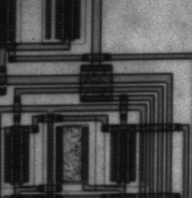
What is Computer Architecture
Instruction Set Architecture (ISA) is a “contract” between SW programmers and HW designers
Programmers
Software (SW)
Instruction Set Architecture
Hardware (HW)
Silicon
Notes:
It is an interface between a programmer and the hardware design. It determines how a program will be executed.
For example, on some embedded microprocessor such as those used to control refrigerators and air conditioning. They may not have floating point operations, only integer operations. On those microprocessors, if a programmer want to execute a program with a lot of floating point operations, each operation will need to be implemented in software because there is no hardware support.

Slide 3
Layers of Abstractions
Programmers
Software Layers
Applications: AI, Security, DNN, Media, Big data
Computer architecture: Cover many levels of abstractions including ISA, organization, and hardware implementation (Micro-architectures)
Compilers
Operating System
Firmware
Instruction Set Architecture
Processor
I/O System
Datapath & Control
Digital Design
Circuit Design
Hardware Layers
Layout & Fab
Silicon

Slide 4
What are Other CS/ECE Courses?
Programmers
Software Layers
Applications: AI, Security, DNN, Media, Big data
Computer architecture: Cover many levels of abstractions including ISA, organization, and hardware implementation (Micro-architectures)
Compilers
Operating System
CSC4180
CSC3150
Firmware
Instruction Set Architecture
CSC3050
Processor
I/O System
network
Datapath & Control
ECE4016
Digital Design
EIE2050
Circuit Design
Hardware Layers
Layout & Fab
Silicon

Slide 5
Computers have driven most technological advancements in the past 50 years
Computer and IC Technology
The performance of computers has improved by 50,000X
Computers everywhere, from the cloud to PCs and smartphones
Internet
WWW, e-commerce, search engine, big data
Social media and IoT
AI
ML, Generative AI, Self-driving, Medical instruments and treatments
Renewable energy resources
Solar, Wind, Hydroelectrical, Geothermal, ….
Notes:
Almost all technical advancements are pushed by the computers

Slide 6
Driving Force behind Information Revolution
Moore’s law:
Moore's Law is a prediction made by Gordon Moore, co-founder of Intel, in 1965. It originally stated that the number of transistors on a microchip would double every year while the costs would be halved. In 1975, Moore revised this forecast to doubling approximately every two years. It has been holding remarkably well for 50 years.
Other related predictions are mistakenly considered Moore’s law, such as “computer performance doubles every 18 months.”
Implications
Each time the cost or performance improves by 10x, new applications emerge. Economically infeasible applications suddenly became practical.
Had the transportation industry matched the progress of the computer industry, we would be able to travel to the moon in 0.001 second.
Notes:
Faster than the speed of light
Many applications used to be “science fiction”, now become reality: computers in automobiles, cell phone, human genome, WWW, search engine, self-driving cars, google glass, cashless society

Slide 7
More Transistors ➔ Higher Performance
More transistors enable increased performance, but how those transistors are used matters.
Computer Architecture determines how those transistors are used to effectively achieve high performance
Multiplyer/Divider
Pipelining
Superscalar/VLIW/Out-of-Order
Multi-cores
Cache hierarchy
Vector/SIMD units
Notes:
Adding more registers (to keep frequently used data) ? Or adding more functional units (for computation). Sometimes, it is the functionality! For example, should you support 32b addressing or 64b addressing.

Slide 8
Driving Force behind Information Revolution
Moore’s law:
Moore's Law is a prediction made by Gordon Moore, co-founder of Intel, in 1965. It originally stated that the number of transistors on a microchip would double every year while the costs would be halved. In 1975, Moore revised this forecast to doubling approximately every two years. It has been holding remarkably well for 50 years.
Other related predictions are mistakenly considered Moore’s law, such as “computer performance doubles every 18 months.”
Implications
Each time the cost or performance improves by 10x, new applications emerge. Economically infeasible applications suddenly became practical.
Had the transportation industry matched the progress of the computer industry, we would be able to travel to the moon in 0.001 second.
Notes:
Faster than the speed of light
Many applications used to be “science fiction”, now become reality: computers in automobiles, cell phone, human genome, WWW, search engine, self-driving cars, google glass, cashless society

Slide 9
Classes of Computers (1)
Desktop computers (PC/Workstations)
Designed to deliver good performance to a single user at a low cost.
Servers/Mainframes
To run larger programs for multiple users simultaneously, typically accessed via a network, emphasizing dependability and security.
Embedded computers (microprocessors)
A computer within another system with a dedicated function or application. E.g., digital cameras, automobiles, medical devices, network switches, and home appliances.

Slide 10
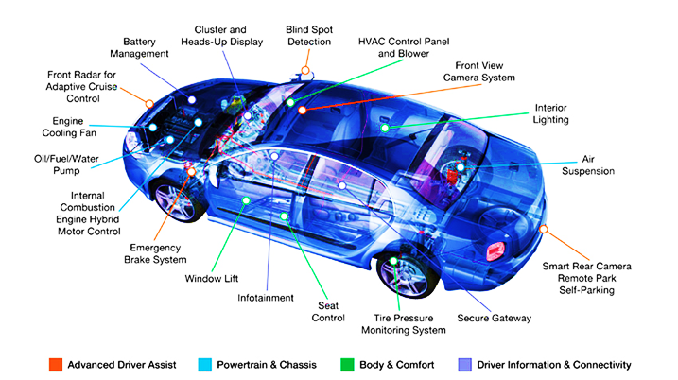
Automotive Embedded Systems
Classes of Computers (2)
https://dcvizcayno.wordpress.com/2015/08/28/the-future-of-technology-privacy-security-and-risks-part-3-of-5/
Notes:
Those are controlled by micro-controller or processors. For luxuary car (Tesla model S or Benz – S), it may have 150-200 processors. Self-driving cars take more

Slide 11
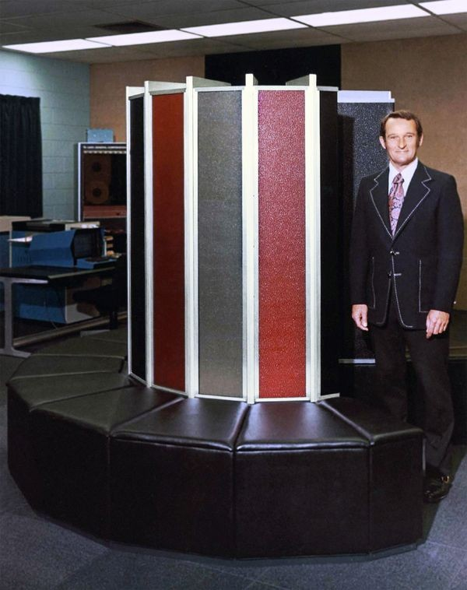
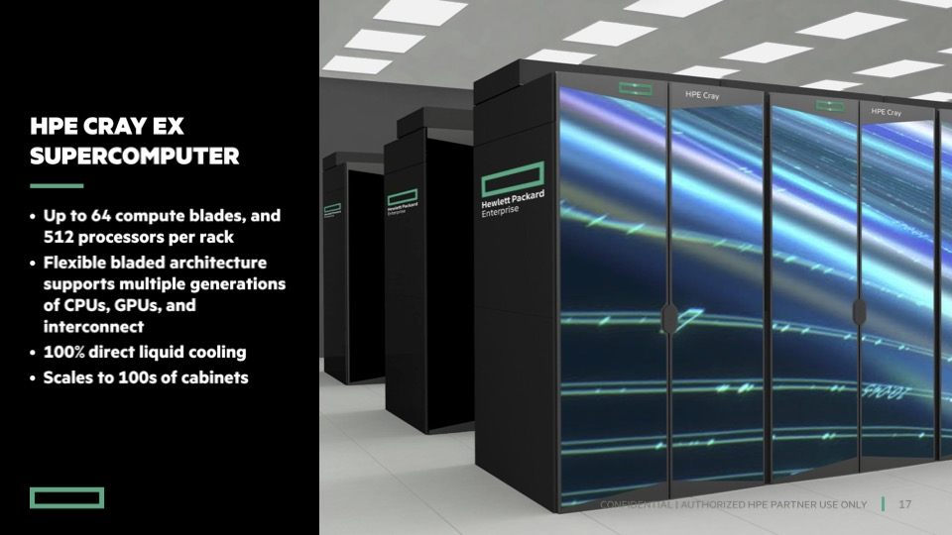
Classes of Computers (3)
Supercomputers
A class of computers with the highest performance and cost; with modern supercomputers often reaching into the petaFLOPS (10^15 FLOPS) and exaFLOPS (10^18 FLOPS) range.
The applications include climate and weather modeling, physical simulations (like simulations of atomic interactions or astronomical phenomena), cryptographic analysis, and other scientific and engineering problems that cannot be solved within a reasonable time frame on less powerful machines.
1976
Cray-1
killo, mega, giga, tera, peta, exa, zetta, yotta
2023
thousand,million,billion,trillion,quadrillion, quintillion,sextillion,
Notes:
What if there are hypersonic missiles coming, if you cannot figure out how to intercept faster enough, you will get hit.
Peta is quadrillion and exa is quintillion
In 76, that was a single processor system. 80MFlops, Today the top 1 has 6M processing cores. 1chip contains 220 cores
Killo, mega, … prefix for very large numbers, like milli, micro, nano, for very small numbers

Slide 12
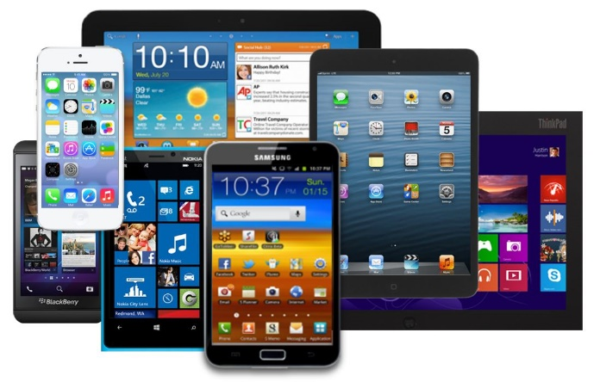
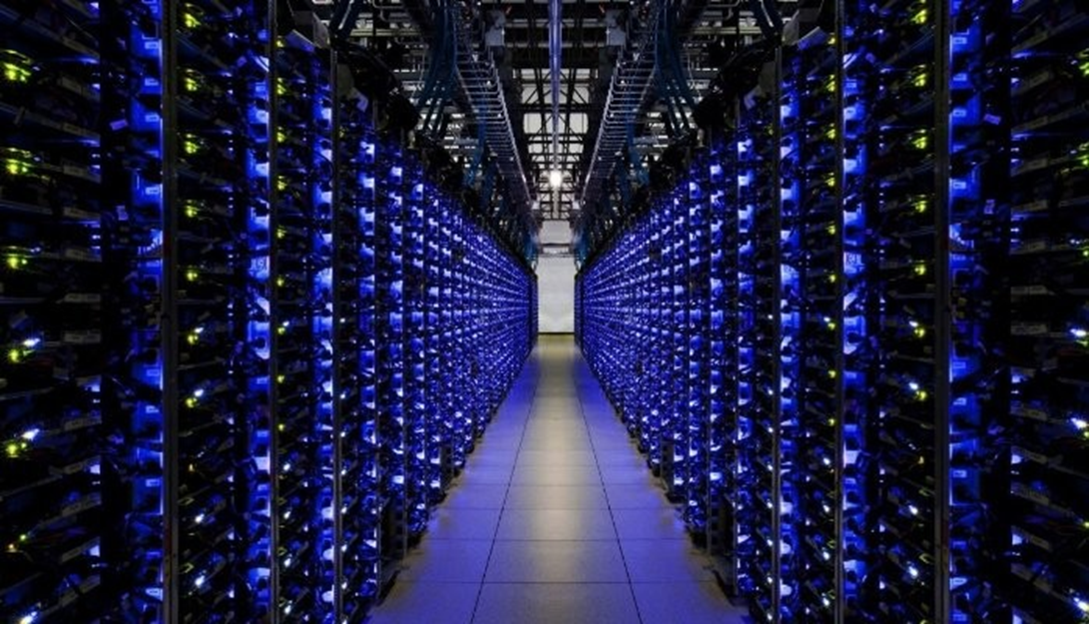
Post-PC Era
Personal Mobile Devices
Towards the light-weight direction
Battery-operated devices with wireless connectivity.
Touch screen interface
Warehouse-Scale Computers
Towards the large-scale direction
Datacenter containing hundreds of thousands of servers providing software as a service (SaaS).
Notes:
向两个方向发展，一个是轻量级的mobile方向，一个是大规模的方向 such as data centers and WSC
This is the today’s Cloud-Edge computing. Which market is greater? Edge, but which margin is greater?
Data center (cloud) is a collection of servers. Deliver services through the internet.
Cloud and Edge

Slide 13
Supercomputers vs. Whare-House Computers
Features | Supercomputers | WSC (Whare-House Computer)
Primary goal | Maximize performance for a single application; Low latency computing | Handle massive data and internet services; High throughput computing
Architecture | Tightly coupled (e.g. shared memory), centralized designs, specialized parts | Distributed, commodity servers
Interconnect | High bandwidth, low latency, custom-designed network | Standard networking (Ethernet, InfiniBand)
Target applications | Scientific simulation, modeling, weather forecasting, AI training | Web services, cloud computing, data analytics
Scalability | Limited by specialized hardware | Highly scalable with commodity hardware
Cost | Very high | Lower per unit of computing power
Notes:
Low latency: airplane, fast, but 500 people, high throughput: trains can carry 20K, but takes longer

Slide 14
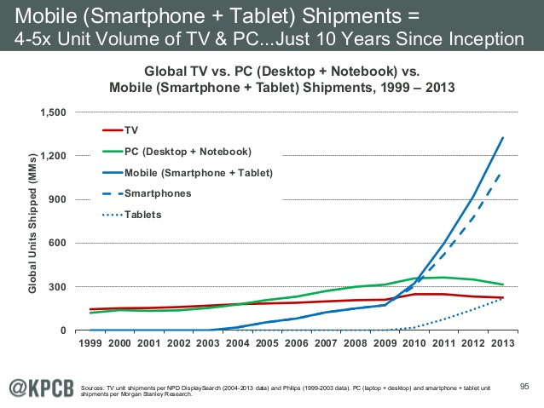
Embedded vs. Desktop

Slide 15
Embedded vs. Desktop
2016
Notes:
What would be the next wave? Health/wellness integration? Computer vision, AI tablet/PC?, foldable devices? Cyber security, Cloud, IoT, Big Data analytics

Slide 16
Embedded vs. Desktop
New growing areas in recent years:
AI devices/NLP/AI-PC
Computer vision
Robotics
Healthcare/Wellness devices
2016
2024?
Notes:
What would be the next wave? Health/wellness integration? Computer vision, AI tablet/PC?, foldable devices? Cyber security, Cloud, IoT, Big Data analytics

Slide 17
1.2 Eight Great Ideas in Computer Architecture
Design for Moore’s Law
Use Abstraction to Simplify Design
Make Common Case Fast
Performance via Parallelism
Performance via Pipelining
Performance via Prediction
Hierarchy of Memories
Dependability via Redundancy
Notes:
HLL vs assembly
TensorFlow vs C or CUDA
They were not necessarily invented by computer architecture people. The early architects invented them and successfully applied them, and later architects imitated them.
If you master such ideas, you could be a competent architect someday.

Slide 18
1.2 Seven Great Ideas in Computer Architecture
In the Sixth edition of this textbook, eight ideas have been reduced to seven.
Use Abstraction to Simplify Design
Make Common Case Fast
Performance via Parallelism
Performance via Pipelining
Performance via Prediction
Hierarchy of Memories
Dependability via Redundancy
Notes:
Dennard scaling stopped, and Moore’s law slowed down. Now it is about doubling every 2.5 to 3 years.

Slide 19
Eight Great Ideas in Computer Architecture
Design for Moore’s Law: Must anticipate where the technology will be
Use Abstraction to Simplify Design: Use abstraction to characterize the design at different levels. Low-level details can be hidden.
Make Common Case Fast: Must know what are common cases
Performance via Parallelism: ILP,TLP, DLP,MLP, RLP
Performance via Pipelining: e.g. car assembly pipeline. buffet pipeline
Performance via Prediction: Guess and start working rather than waiting
Hierarchy of Memories: How to get fast, large, and cheap memory
Dependability via Redundancy: Make the system dependable/reliable by having redundant components.
Notes:
Not necessarily invented by computer architecture people. These are time tested ideas.
Pipelining started from CDC7600

Slide 20
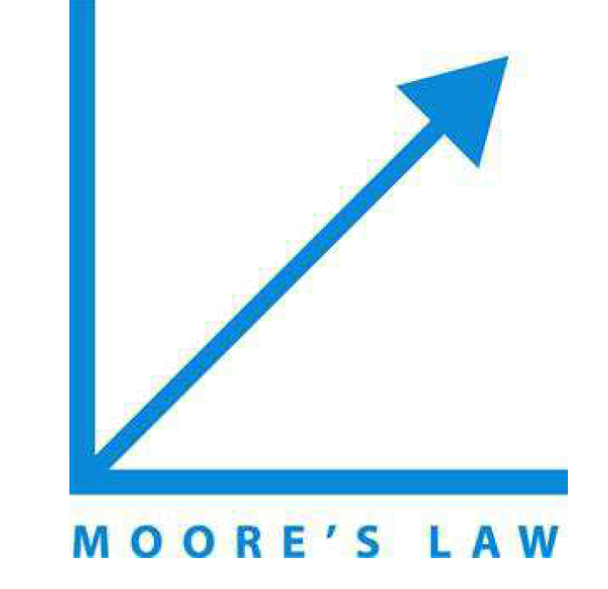






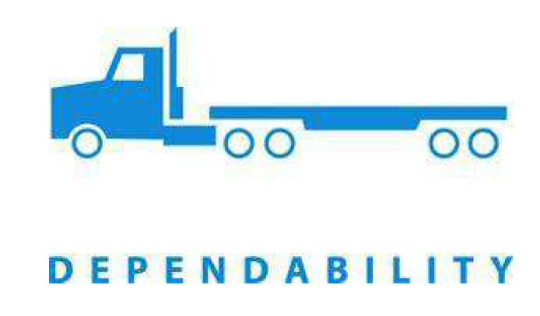
Eight Great Ideas in Computer Architecture
Design for Moore’s Law
Use Abstraction to Simplify Design
Make Common Case Fast
Performance via Parallelism
Performance via Pipelining
Performance via Prediction
Hierarchy of Memories
Dependability via Redundancy
Notes:
Moore’s law– exponential growth, race car: common case is two passenger car, jet airplane: speed, parallel engines, truck is durable and reliable.

Slide 21
1.3 Below Your Program
One user application, say,
a DBMS, may consist of
millions lines of C/C++ code.
Application Software
System Software
Hardware
Hardware only knows
how to execute simple
instructions
Notes:
Not necessarily invented by computer architecture people

Slide 22
1.3 Below Your Program
DBMS implemented in HLL (C or C++)
and many library calls (i.e. API, Application Program Interface)
Application Software
System Software
Compiler translates API and HLL
into object code modules (e.g .o)
Hardware
Linker combined .o into one executable
OS creates a process to run this executable and schedules the process to run on one of the processors.
Notes:
Not necessarily invented by computer architecture people

Slide 23
System Software
Operating System (3150)
Supervising program that interfaces the user’s program with the hardware (e.g., Linux, iOS, Windows)
Handles basic input and output operations
Allocates storage and memory
Provides for protected sharing among multiple applications
Compiler (4180)
Translate high-level language programs (e.g., C/C++, Java) into machine instructions that the hardware can execute
Application Software
System Software
Hardware
Notes:
MIPS: Microprocessor without interlocked piped stages

Slide 24
From HLL to ML (Machine Language)
High-level language program (in C)
swap (int v[], int k) {
int temp;
temp = v[k];
v[k] = v[k+1];
v[k+1] = temp;
}
Assembly language program (for RISC-V)
swap: slli x2, x11, 2
add x2, x10, x2
lw x15, 0(x2)
lw x16, 4(x2)
sw x16, 0(x2)
sw x15, 4(x2)
jalr x31
Machine (object) code (for RISC-V)
0000000 00010 01011 000 00010 1000000
0000000 00010 01010 000 00010 0110011
one-to-many
C Compiler
Compiler can translate HLL
into binary
directly.
one-to-one
Assembler
DisAssembler
Notes:
Optimization: many to many, code generation is one to many.

Slide 25
1.4 Under the Covers
Computer organization
Processor (control, datapath)
Input (keyboard, mouse, touch screen, other interfaces)
Output (display, printer)
Memory (cache, SRAM, DRAM, disk drive, Flash memory, CD/DVD)
Our focus
Architecture: ISA (Instruction Set Architecture) -- Interface between HW and SW.
Micro-Architecture (Implementation):
processor (control and datapath)
interaction with memory systems
Different forms of parallelisms
Implemented using millions to billions of transistors; impossible to understand by looking at each transistor. We need abstractions
Notes:
transistors : 晶体管

Slide 26
Major Components of a Computer
Control
Input
Output
Data
Path
Memory

Slide 27
Instruction Set Architecture (ISA)
ISA, or simply architecture – the abstract interface between the hardware and the lowest level software that includes all the information necessary to write a machine language program, including instructions, registers, memory access, I/O, etc.
Enables implementations (Micro-architectures) of varying cost and performance to run identical software. (i.e. a processor family, such as IBM 360, Intel x86, ARM)
The combination of the basic instruction set (the ISA) and the operating system interface is called the Application Binary Interface (ABI).
The user portion of the instruction set plus the operating system interfaces used by application programmers.
Define a standard for binary portability across computers.
Notes:
For a family of processors. ISA is important – it is a standard interface. Once you have a standard, then compatibility becomes an issue.
Intel: i3,i5,i7,i9; IBM 360 from low end to high end 200x , ARM: A53/A57/A72/R82…

Slide 28
Instruction Set Architecture (ISA)
Applications
Operation System
Software
Compiler
System calls
Instruction Set Architecture
Memory System
Processor
I/O System
Network
Datapath & Control
Hardware
Digital Design
Circuit Design
Micro-architecture:
Single cycle
Multiple cycle
Pipelined
Superscalar
Out-of-order
ISA (or Architecture) is a contract that an architect must follow while designing a machine for a specific Performance, Power and Area (PPA) objective.

Slide 29
ABI (Application Binary Interface)
Applications
ABI
Operation System
Instruction Set Architecture
Compiler
System Calls
Memory System
Processor
I/O System
Network
Datapath & Control
Digital Design
Circuit Design
ISA + System call interface
Example: A program is compiled for Windows/x86 ABI
It contains Windows system calls and x86 instructions
This binary can usually run on only Windows/x86 machines

Slide 30
How do the Pieces Fit Together?
Applications
Operation System
CSC3150
CSC4180
Instruction Set Architecture
Compiler
System Calls
CSC3050
Memory System
Processor
I/O System
Network
ECE4016
Datapath & Control
Digital Design
EIE2050
Circuit Design
Coordination of many levels of abstraction
Under a rapidly changing set of forces
Design, measurement, and evaluation

Slide 31
Data Path and Control
Control responsible for
Instruction fetch and decode
Issue signals that control the way information flows between datapath components
Control what operations the datapath’s functional units perform
Datapath responsible for
Execute instructions – functional units (e.g., adder) and storage locations (e.g., register)
Interconnect the functional units so that the instructions can be executed as required
Load data from and store data to memory

Slide 32
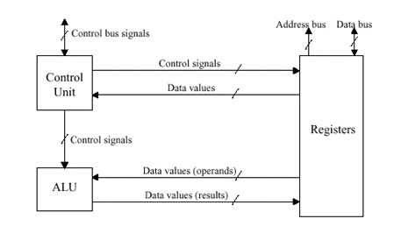
Data Path and Control
Control responsible for
Instruction fetch and decode
Issue signals that control the way information flows between datapath components
Control what operations the datapath’s functional units perform
Datapath responsible for
Execute instructions – functional units (e.g., adder) and storage locations (e.g., register)
Interconnect the functional units so that the instructions can be executed as required
Load data from and store data to memory

Slide 33
Code and Data Input to Device
Executable
000000 00000 00101 0001000010000000
000000 00100 00010 0001000000100000
100011 00010 01111 0000000000000000
100011 00010 10000 0000000000000100
101011 00010 10000 0000000000000000
101011 00010 01111 0000000000000100
000000 11111 00000 0000000000001000
Data
Processor
Memory
Devices
001000 00000 00101
000100 00100 00010
100011 00010 01111
100011 00010 10000
101011 00010 01111
000000 11111 00000
Network
Control
Input
Datapath
Output

Slide 34
Code and Data Stored in Memory
Processor
Memory
Devices
000000 00000 00101 0001000010000000
000000 00100 00010 0001000000100000
100011 00010 01111 0000000000000000
100011 00010 10000 0000000000000100
101011 00010 10000 0000000000000000
101011 00010 01111 0000000000000100
000000 11111 00000 0000000000001000
Network
Control
Input
Datapath
001000 00000 00101
000100 00100 00010
100011 00010 01111
100011 00010 10000
101011 00010 01111
000000 11111 00000
Output

Slide 35
Code Fetch from Memory
PC: Program Counter
Processor
Memory
Devices
Network
Control
000000 00000 00101 0001000010000000
000000 00100 00010 0001000000100000
100011 00010 01111 0000000000000000
100011 00010 10000 0000000000000100
101011 00010 10000 0000000000000000
101011 00010 01111 0000000000000100
000000 11111 00000 0000000000001000
Input
Datapath
Output
Processor fetches an instruction from memory

Slide 36
Decoding Code
Processor
Memory
Devices
Network
Control
000000 00100 00010 0001000000100000
Input
Datapath
Output
Control decodes the instruction to determine what to execute

Slide 37
Executing Code (1)
Register: A temporary storage to hold data so that the CPU can access the
data for computation
Processor
Memory
Devices
Control
Network
000000 00100 00010 00010000000010000
Input
Datapath
001000 00000 00101
000100 00100 00010
100011 00010 01111
100011 00010 10000
101011 00010 01111
000000 11111 00000
Ld reg x4, 0(x1)
Lui reg x2, 0x1234
registers
Output
Control decodes the instruction to determine what to execute
Datapath executes the instruction as directed by control

Slide 38
Executing Code (2)
Processor
Memory
Devices
Network
Control
000000 00100 00010 0001000000000100
Input
Datapath
Add Reg #4 and Reg #2, put result in Reg #2
Output
Control decodes the instruction to determine what to execute
Datapath executes the instruction as directed by control

Slide 39
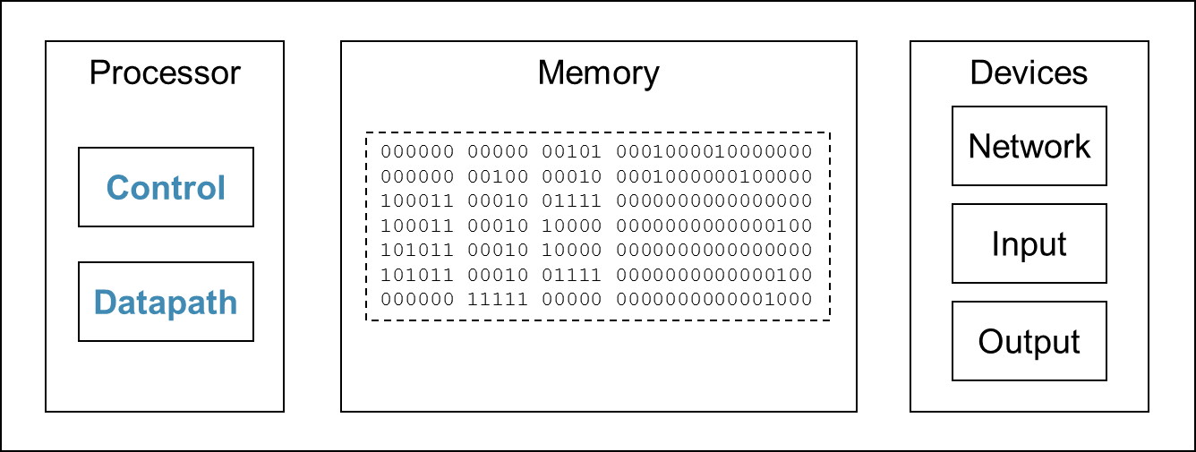
The Cycle
Fetch
Execute
Decode
Processor fetches the next instruction from memory
How does it know which location in memory to fetch from next?
PC = PC + 4 or
PC = PC + branch distance
Notes:
IPC: Instruction Program Counter

Slide 40
Output device outputs data
Processor
Memory
Devices
Network
Control
Input
Datapath
Output
00000100010100000000000000000000
00000000010011110000000000000100
00000011111000000000000000001000

Slide 41
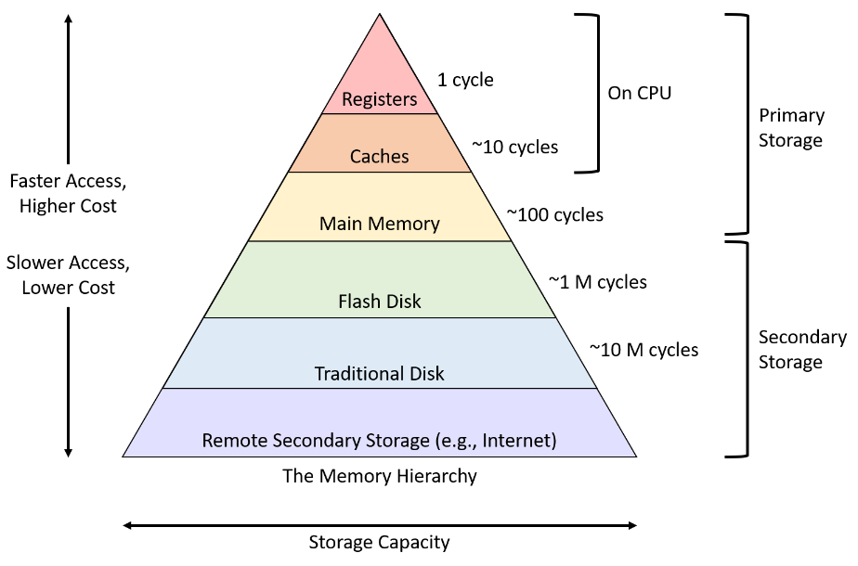
Memory Hierarchy
Volatile
Non-volatile

Slide 42
Memory Hierarchy
A memory hierarchy is a structured arrangement of different types of memory in a computer system designed to balance the trade-offs between speed, cost, and capacity.
It exploits the principle of locality to provide faster access to frequently used data by placing them in smaller but faster memory closer to the processor.
Spatial locality (locality in space)
Temporal locality (locality in time)

Slide 43
Memory Latency and Bandwidth
Latency: The time it takes for a processor to access data stored in memory. It's the delay between a request for data and when it is actually available.
Bandwidth: The amount of data that can be transferred between the processor and memory per unit of time. Bandwidth can be affected by the memory cycle time, the bus speed and width, the interconnection network width, and so on. If the memory bandwidth is insufficient, effective memory latency will increase.
Caches can reduce the latency and increase the bandwidth
Example: DRAM cycle time 60ns, SRAM cycle time 1ns
Example: HBM3 1024pins, GDDR6 ~190 pins
Notes:
From SF to NY, it takes 18 hours, it is the latency. But sometimes it takes 30 hours, why? Because the road is jammed with traffic. The traffic would reduce if the road has 8 lanes. 8 lanes is bandwidth.

Slide 44
Caches
A cache is a small, high-speed memory that stores frequently accessed data and instructions, acting as a buffer between the processor and the slower main memory (RAM).
When the processor needs data, it first checks the cache. If the data is found (a cache hit), it can be accessed much faster than retrieving it from the main memory.
Caches have been adopted for all the memory hierarchy.
CPU cache
Disk cache
Web browser cache
Akamai edge caching to store video content at many edge servers.

Slide 45
CPU Cache Hierarchy
registers
Split cache:
To double the bandwidth
L1-Icache
L1-Dcache
16KB-64KB
Unified cache:
To increase the hit rate
L2 Unified Cache
256KB-2MB for PC/WS
upto 8MB for servers
L3 Unified Cache (last level cache, usually shared across multicores)
Large L3 cache:
To reduce memory traffic
4MB-64MB
Notes:
Zoom in to the on-chip cache hierarchy

Slide 46
Volatile vs Non-Volatile (NV) Memory
Volatile Memory:
If we were to lose power to the computer, everything in the memory would be lost because the memory (SRAM and DRAM) in a processor is volatile. When it loses power, it forgets. Main memory or primary memory are usually referring to the DRAM memory.
NV memory:
In contrast, any storage external to the processor is non-volatile,
such as Flash memory, SSD, CD/DVD, Blu-ray, Disks, Tapes. They are usually belong to the secondary memory.

Slide 47
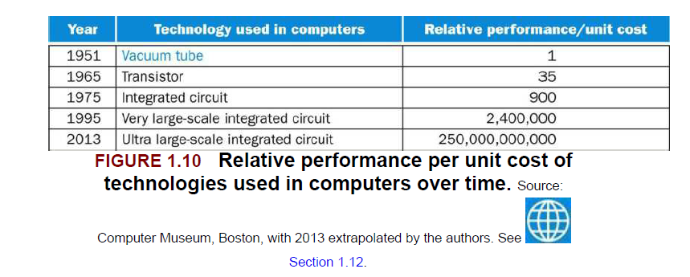
1.5 Technologies for Building Processors and Memory
Both processors and memory have improved at an incredible rate. The technologies that have been used over time is shown below.
Notes:
transistors : 晶体管

Slide 48
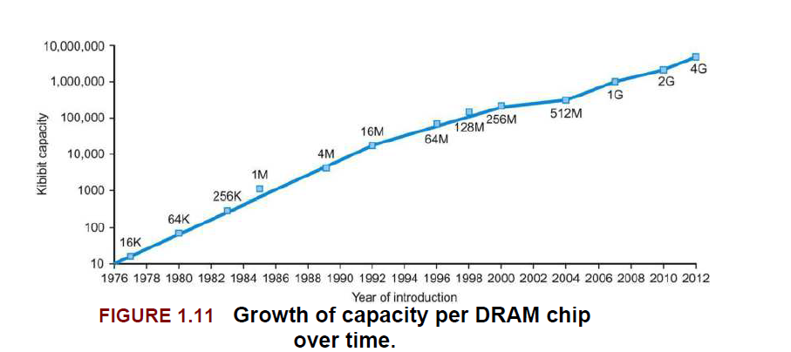
32Gb/64Gb
2023/4

Slide 49
Impacts of Advancing Technology
Processor
Logic capacity: increases about 30% per year
Performance: 2× every 1.5 years
Memory
DRAM capacity: 4× every 3 years, about 60% per year
Memory speed: 1.5× every 10 years
Cost per bit: decreases about 25% per year
Storage
Capacity: increases about 60% per year

Slide 50
VLSI and ULSI
VLSI refers to ICs containing tens of thousands to a few million transistors. (1980’s)
ULSI extends the scale of integration even further, referring to chips with millions or billions of transistors.
Nvidia RTX 4090 chip contains 76B transistors, Blackwell, 104B, and AMD’s latest CPU has 10-30 billion transistors; perhaps it is time to consider something beyond ULSI and go for ELSI (Extreme-Large Scale Integration) or HLSL (Hyper-Large Scale Integration)
Notes:
transistors : 晶体管

Slide 51
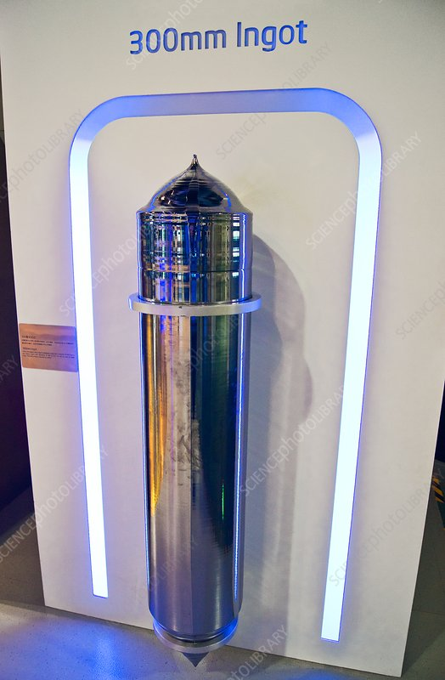
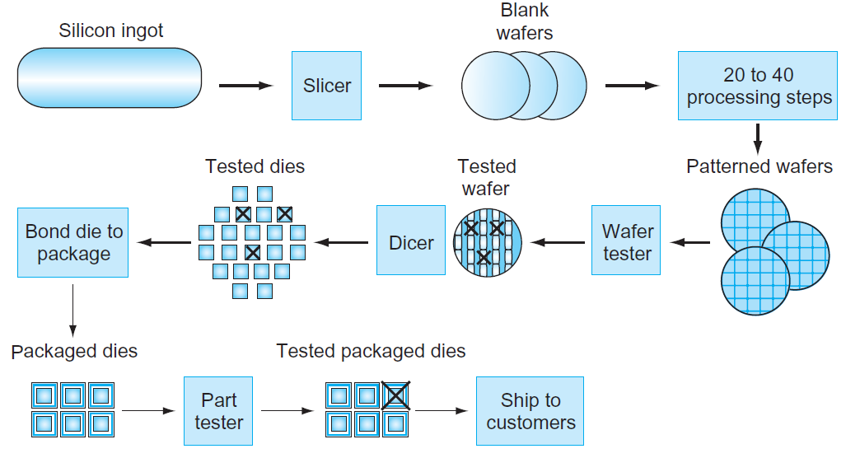
IC Manufacturing Process
Yield: proportion of working dies per wafer.
Notes:
silicon ingot: 硅锭
wafer和die的区别
wafer 即为图片所示bai的晶圆，由纯硅（Si）构成。一般分为6英寸、8英寸、12英寸规格不等，晶片就是基于这个wafer上生产出来的。
Wafer上的一个小块，就是一个晶片晶圆体，学名die，表示晶片，晶粒，封装后就成为一个颗粒。晶粒是组成多晶体的外形不规则的小晶体，
yield: 成品率，即合格芯片dies数占总芯片数的百分比

Slide 52
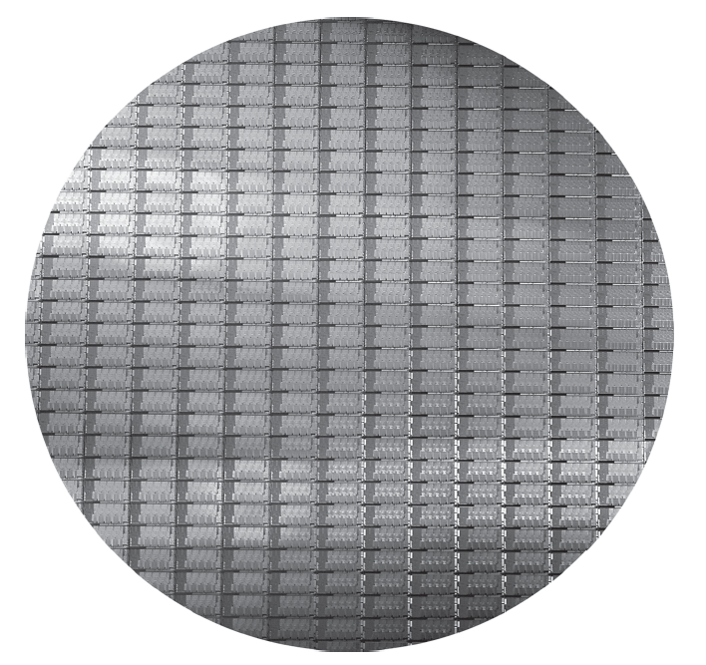
Intel Core i7 Wafer
300-mm wafer, 280 dies at 100% yield (32-nm technology).
Notes:
die是晶粒的意思，wafer是晶圆的意思 300-mm is 12 inches wafer
Blackwell die is about 4X the size of i7.

Slide 53
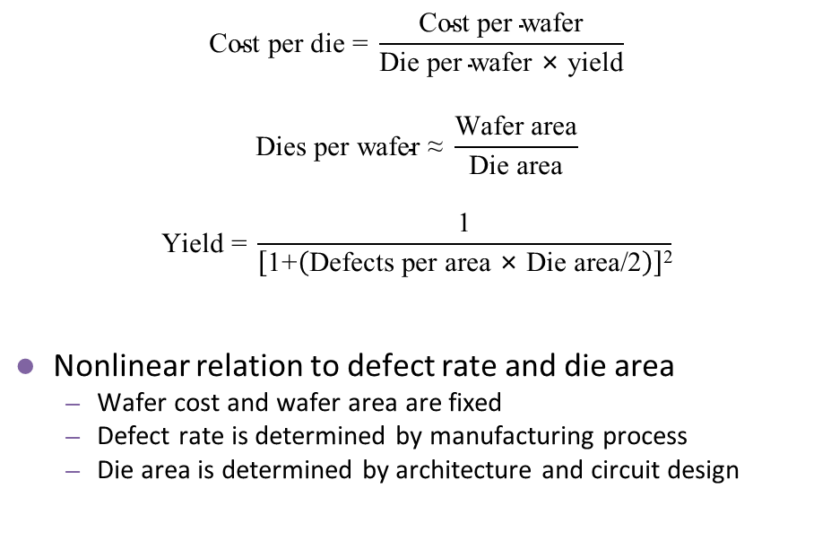
Integrated Circuit Cost
$$\text{Cost} \text{per} \text{die}\text{ = }\frac{\text{Cost} \text{per} \text{wafer}}{\text{Die} \text{per} \text{wafer}\text{ × }\text{yield}}$$
$$\text{Dies} \text{per} \text{wafer}\text{ ≈ }\frac{\text{Wafer} \text{area}}{\text{Die} \text{area}}$$
$$\text{Yield}\text{ = }\frac{\text{1}}{\left[\text{1+}\left(\text{Defects} \text{per} \text{area}\text{ × }\text{Die} \text{area}\text{/2}\right)\right]\text{2}}$$
Nonlinear relation to defect rate and die area
Wafer cost and wafer area are fixed
Defect rate is determined by manufacturing process
Die area is determined by architecture and circuit design
A single 300 mm wafer built on the 5nm
process by TSMC costs approximately $17,000
We may get ~100 dies (nVidia RTX3090)
from such a wafer, or 470 dies for intel i7.
We may get ~30 good dies (nVidia Blackwell) from such a wafer in 4nm.
Notes:
defect rate：不良率
第一个公式是直接导出的，第二个公式是近似的，第三个公式是厂家的经验公式

Slide 54
Impact of Yields
Yield: the percentage of functional integrated circuits (ICs) or dies produced from a wafer that pass all quality and performance tests
Yield is a critical metric in semiconductor manufacturing. It represents the percentage of usable chips produced from a wafer and directly impacts production costs, profitability, product availability, and technological advancements.
Intel was the leader in IC manufacturing between mid-1990 and mid-2010. Intel has repeatedly suffered from low yield issues from 10nm and 7nm in recent years down to the most recent 1.8nm processes. TSMC, on the other hand, has consistently maintained high yields in its processes.
Intel is counting on its latest 18A (1.8nm) process to revive it. However, Broadcom’s recent test of Intel’s 18A process was not satisfactory, which has dealt a severe blow to Intel’s plan to save its fabrication business.
Notes:
Intel loses many thousands USD on manufacturing one wafer while TSMS makes 5-6 thousands.

Slide 55
Why Unified Cache could yield a higher hit rate
2KB
Unified
Cache
1KB
I-cache
1KB
D-cache
A scientific program may have a small I-cache footprint: a small loop that accesses a few large arrays, so it may need 0.1KB of I-cache and 1.8KB of data cache space. The split cache will get into intensive D-cache misses.
A DBMS program may have a large I-cache footprint: a large loop that accesses a few tables, so it may need 1.8 KB of I-cache and 0.1 KB of data cache space. The split cache will get into intensive I-cache misses.
Notes:
Intel loses many thousands USD on manufacturing one wafer while TSMS makes 5-6 thousands.

Slide 56
1.6 Performance
Performance is an important attribute of a computer.
_{Defining Performance}
Which airplane has the best performance?
The Concorde has the highest cruising speed, the DC-5-80 has the longest range, and the 747 has the largest capacity.
Airplane | Passenger capacity | Cruising range (miles) | Cruising speed (miles per hour) | Passenger throughput
Boeing 777 | 375 | 4630 | 610 | 228750
Boeing 747 | 470 | 4150 | 610 | 286700
Concorde | 132 | 4000 | 1350 | 178200
DC-8-50 | 146 | 8720 | 544 | 79424
Notes:
Performance is often the number #1 attribute of a computer. Other attributes are power, connectivity, cost, architecture, portability, easy to use? User friendly? and so on.

Slide 57
Performance Metrics
Response time or Execution time or Latency
Total time required for the computer to complete a task
Throughput or Bandwidth
The number of tasks completed per unit of time
Tests
On Nvidia Blackwell, accessing the memory takes 320-500 clock cycles
On Nvidia Blackwell, with HBM3 memory, the peak transfer rate is 5.5TB/s
My cell phone can answer your query in 3 seconds
My server can handle 1000 trade transactions per second.
Lower latency can increase throughput, but not vice versa
If a single job can be divided into many independent small tasks, high thruput can also reduce latency

Slide 58
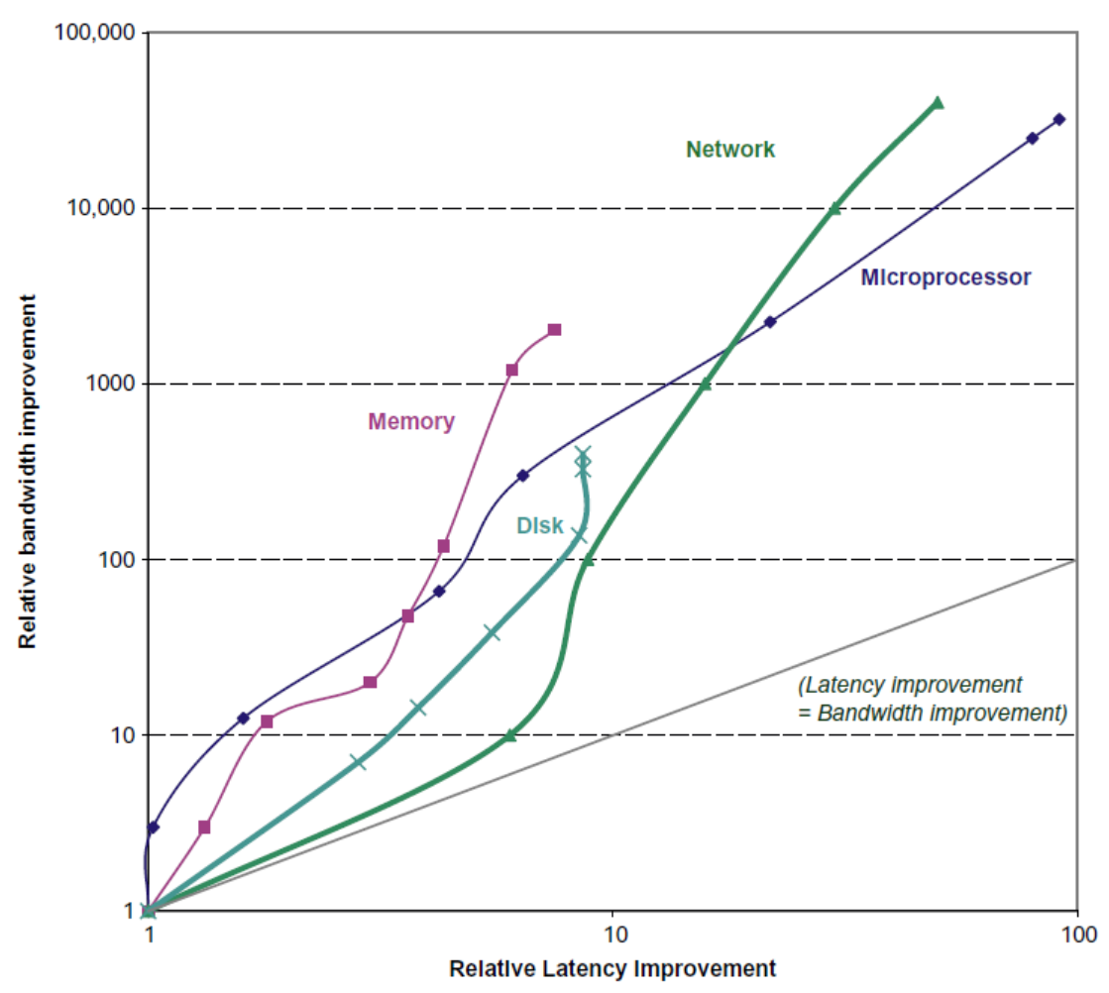
Latency (Response Time) and Bandwidth (Throughput)
Log-log plot of bandwidth and latency improvement over 25-40 yrs.
Latency improved 8–91 ×
Bandwidth improved about 400–32,000 ×.
Except networking, modest improvements in latency and bandwidth in other three technologies since ~2012: 0%–23% in latency and 23%–70% in bandwidth.

Slide 59
Example Machines
Latency-centric computers
Focus: Minimizing time to complete a single operation or task.
The emphasis is on responsiveness and fast individual response times.
Example: desktop, PC, laptop, mobile devices, game consoles, HFT (high-frequency trading systems), supercomputers, and real-time systems.
Throughput-centric computers
Focus: Maximizing the total work completed within a given time.
The emphasis is on concurrently processing large data or many operations.
Example: Servers for Web Applications and Cloud Services. Data Centers and warehouse computers. GPUs and Oracle DB machines (SUN Niagra Falls or ROC), Batch systems, and Network routers.

Slide 60
Measuring Performance
Time is the measure of computer performance
Wall clock time, Response time, or elapsed time
Total time to complete a task, including disk accesses, memory accesses, I/O, and OS overhead.
CPU Time
User CPU time
System CPU time
Use System Performance to refer to elapsed time
Use CPU Performance to refer to user CPU time
This chapter is focused on CPU Performance
Speedup of X relative to Y
Execution time_{Y} / Execution time_{X}
Example: The old program runs in 100 seconds. Your optimization reduces the time to 80 seconds. What is the speedup? 100/80 = 1.25x or 25% faster.
Notes:
Most Chinese engineers work in the performance area: number speaks for itself

Slide 61
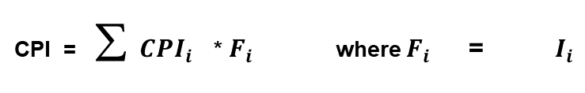
Aspects of CPU Performance
CPU time = Seconds = Instructions x Cycles x Seconds
Program Program Instruction Cycle
Average Cycles per Instruction
CPI = (CPU Time * Clock Rate) / Instruction Count
= Cycles/ Instruction Count
Instruction Frequency
n
CPI = ∑ ${CPI}_{i}$ * $F_{i}$ where $F_{i}$ = ${ I}_{i}$
i = 1
Instruction Count
Invest resources where time is spent!
61

Slide 62
Power Issue
P_{dynamic} = 0.5 × C_{L} × V_{dd}² × f_{switching}
CL is the load capacitance, which is the charge go in and out of a transistor
_{Vdd is the supply voltage}
_{f is the clock frequency}
This is per transistor dynamic power, the total power is P x total number of transistors.
When the transistor becomes so small (e.g. close to 22nm), the static power starts to approach the dynamic power. Now high end processes are close to 4-5nm.

Slide 63
Power Issue
P_{dynamic} = 0.5 × C_{L} × V_{dd}² × f_{switching}
Example
If the transistor size shrinks by 2x, the total number of transistors increases by 4X in the same area.
The C_{L} may decrease by 2x
Assuming the frequency is doubled to 2x
How much should we lower the V_{dd} to maintain the same dynamic power consumption?
New P = Old P x 4 x ½ x 2 x ?
C_{L}
f
V_{dd}

Slide 64
Dennard Scaling
Dennard scaling refers to the process of reducing the supply voltage of more advanced technologies to operate more transistors with the same power as the older technology
Dennard scaling allowed manufacturers to drastically raise clock frequencies from one generation to the next without significantly increasing overall circuit power consumption.
Since around 2005–2007, Dennard scaling appears to have broken down. When the transistor is very small, further reducing the power may make it unreliable. The current leakage (static power consumption) also causes the chip to heat up.
Notes:
Robert Dennard from IBM. He was an engineer and inventor.

Slide 65
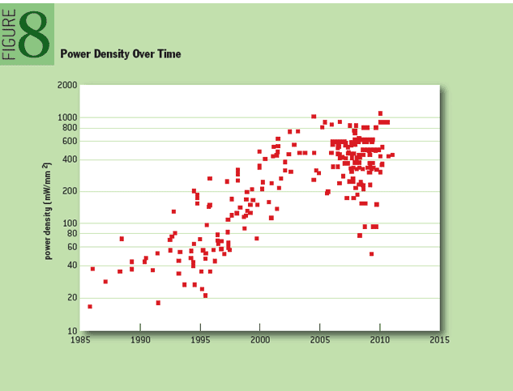
1.7 The Power Wall
The “Power Wall” refers to the difficulty of scaling the performance of computing chips and systems at historical levels, because of fundamental constraints imposed by affordable power delivery and dissipation.
From 1985 to 2005, maximum power per processor chip kept going up, while the chip area is getting smaller, therefore, the power density is shooting up quickly, making it a challenge to dissipate the heat. After 2005, the power density stays flat. (because the clock frequency not increased)
Power Wall
Notes:
Clock frequency keeps increasing, and chip size also increases.

Slide 66
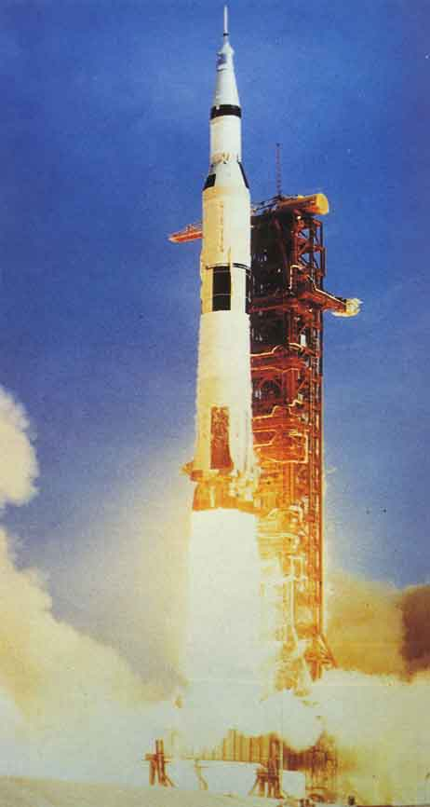
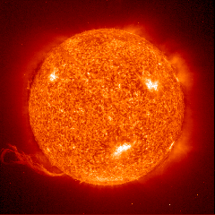
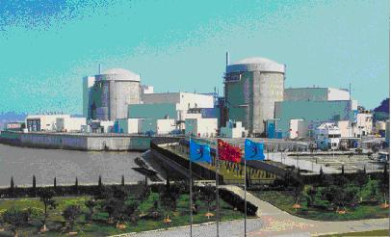
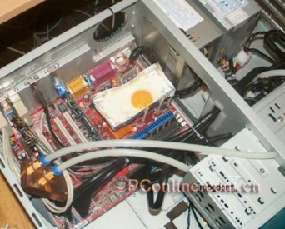
The Power Wall
Dennard
Scaling
10000
Rocket
Nozzle
Sun’surface
1000
Nuclear
Reactor
100
Power Density (W/cm2)
Hot Plate
Increased transistor density
Increased clock frequency
But Vdd cannot be lowered
10
8008
8086
4004
8085
486
P6
Pentium®
386
8080
286
1
1970 1980 1990 2000 2010

Slide 67

Hot Plate

Slide 68
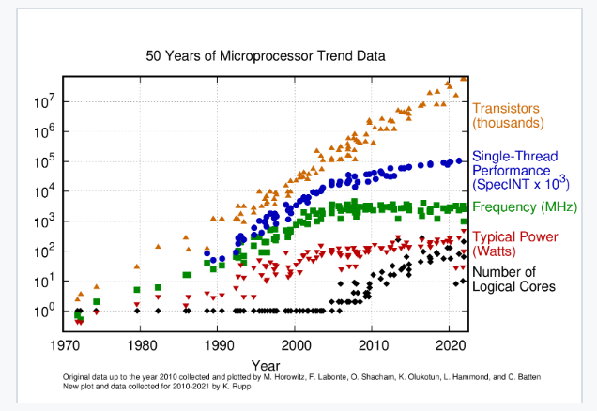
Single thread perf / clock freq / Power / # of Cores
Moore’s Law
1990-2000
Power keeps going up
Notes:
Moore’s law: the number of transistors in an integrated circuit (IC) doubles about every two years

Slide 69
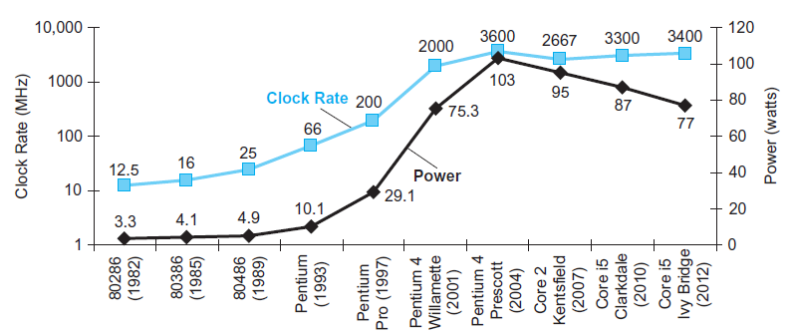
Clock Rate and Power
Pentium 4 had a dramatic jump up in clock rate and power.
Core 2 reverts to simpler pipeline, lower clock rates and multiple processors per chip.
latest Intel chip : i9-10980K, the 10th generation
Notes:
Pentium 奔腾处理器
Core 酷睿处理器
现在intel系列最新的是i9-10980K， i9是品牌标识符，后面的10是第十代，再后面的三位数是SKU标号，最后是产品线后缀，比如K表示解锁

Slide 70
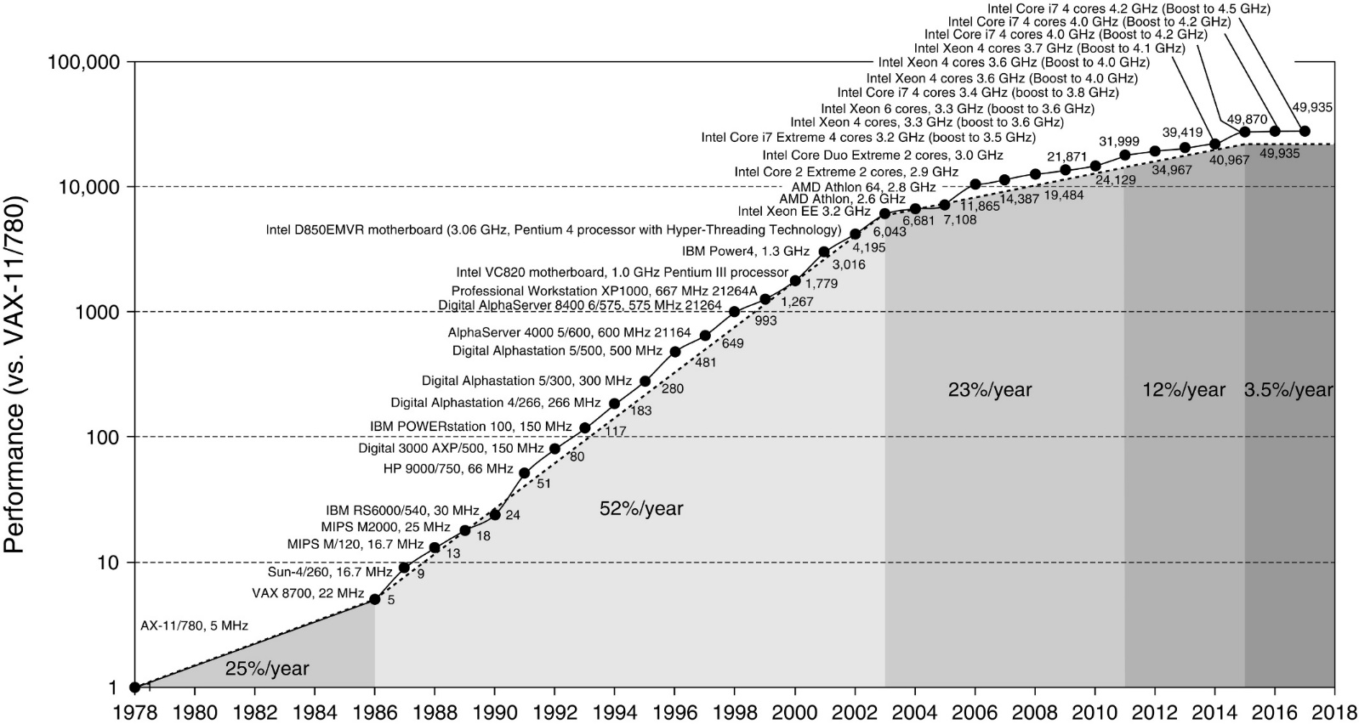
Processor Performance Over 40 Years
Move to multi-processor
RISC
Gordon Moore’s prediction in 1965 (“Moore’s Law”):
Number of transistors doubled every 18 months to 2 years

Slide 71
1.8 The Sea Change: Switch to Multiprocessors
Due to the power wall (also memory wall and ILP wall), single-core performance is not moving much (3.5% per year).
Future performance advancement must rely on using more processors.
No matter you want it or not, today’s processor chip is already implemented with multiple to many cores.
Parallel programming is or will be a basic skill to have.
For the past many years, parallel programming (CSC4005) has been a mandatory course for CSE majors.
Notes:
transistors : 晶体管

